Slide 1
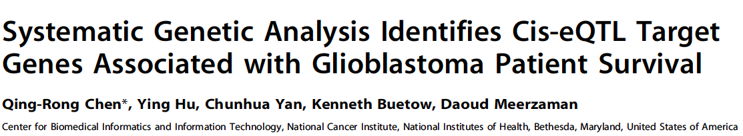
Hank Wu
Department of Epidemiology and Biostatistics
2/3/16

Slide 2
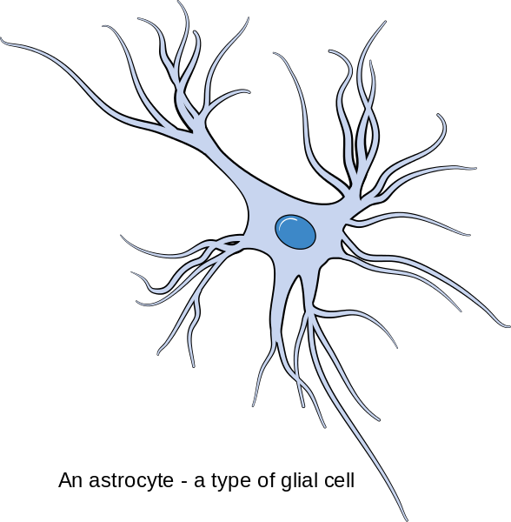
Glioblastoma Multiforme (GBM)
Introduction Data Method Results
Glioma: tumor from the glial cell of brain
50% are GBM
Astrocytoma: one type of glioma
60-75% are GBM
Glioblastoma: the most malignant form of astrocytoma
Highest grade of brain tumor
(grade IV)
https://commons.wikimedia.org/wiki/File:Diagram_of_an_astrocyte_-_a_type_of_glial_cell_CRUK_029.svg
"Glioblastoma and Malignant Astrocytoma.” http://www.abta.org/secure/glioblastoma-brochure.pdf. American Brain Tumor Association (ABTA).

Slide 3
GBM
Introduction Data Method Results
Most common (15.4% are GBM) and lethal primary brain tumor
Prognosis for adults: 14.6 months
Survival Rate | Adults
One-year | 50%
Two-year | 30%
Five-year | 10%
"Glioblastoma and Malignant Astrocytoma.” http://www.abta.org/secure/glioblastoma-brochure.pdf. American Brain Tumor Association (ABTA).
Song, K. S., Phi, J. H.,. . . Kim, S. (2010). Long-term outcomes in children with glioblastoma. Journal of Neurosurgery. Pediatrics, 6(2), 145.

Slide 4
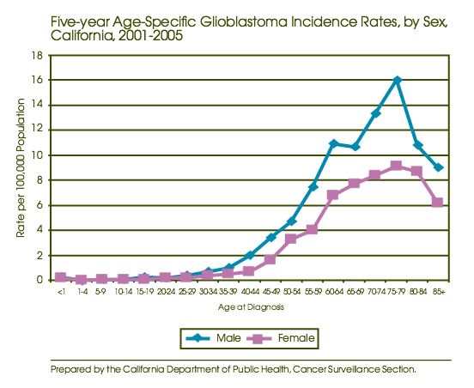
Incidence Rate
Introduction Data Method Results
Gender
Men higher than women (1.3 : 1)
Age
60-84 years old
https://www.cdph.ca.gov/programs/ccr/Documents/GlioblastomaAdult-08.pdf
Muquit, S., Parks, R., & Basu, S. (2015). Socio-economic characteristics of patients with glioblastoma multiforme. Journal of neuro-oncology, 1-5.

Slide 5
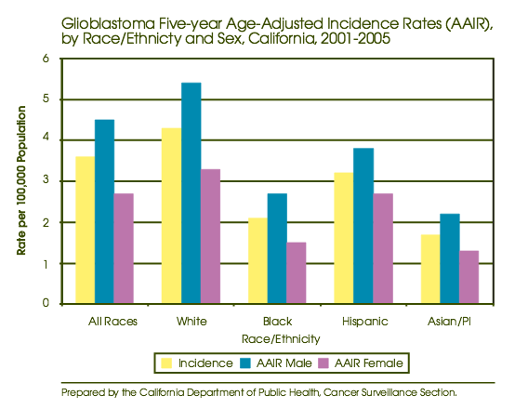
Incidence Rate
Introduction Data Method Results
Race
White twice higher than black
Asian the lowest
"Glioblastoma and Malignant Astrocytoma.” http://www.abta.org/secure/glioblastoma-brochure.pdf. American Brain Tumor Association (ABTA).
https://www.cdph.ca.gov/programs/ccr/Documents/GlioblastomaAdult-08.pdf

Slide 6
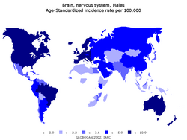
Incidence Rate
Introduction Data Method Results
Region
3-4 cases / 100,000 people per year (North America and European nation)
Lower in South America and Asia
"Glioblastoma and Malignant Astrocytoma.” http://www.abta.org/secure/glioblastoma-brochure.pdf. American Brain Tumor Association (ABTA).
http://www.pubcan.org/cancer/4938/glioblastoma/epidemiology

Slide 7
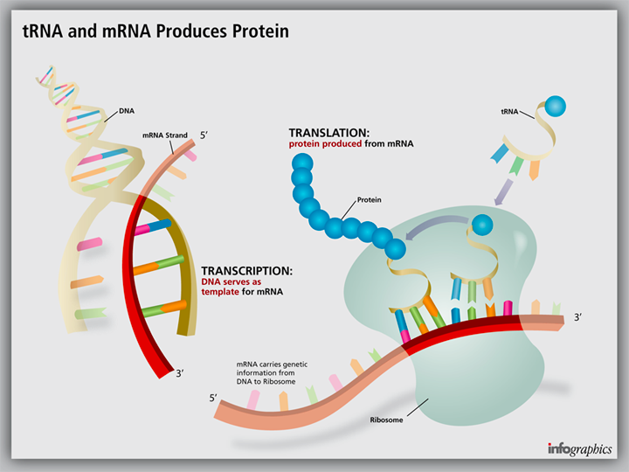
Central Dogma of Biology
Introduction Data Method Results
1
DNA
4
5
protein
2
3
mRNA
http://www.ignyc.com/our-work/portfolio/transcription-translation/

Slide 8
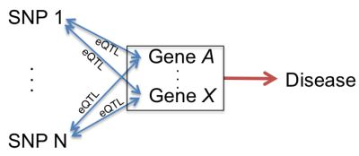
eQTL
Introduction Data Method Results
Expression Quantitative Traits Loci
Loci that control transcript level
Gene Expression (quantitative traits)
Process by which the information contained within a gene becomes a useful product (e.g., protein)
Association between genetic polymorphisms and transcript level
https://www.fredhutch.org/en/news/spotlight/imports/upgraded-genomic-association-analysis-via-new-software-platform.html

Slide 9
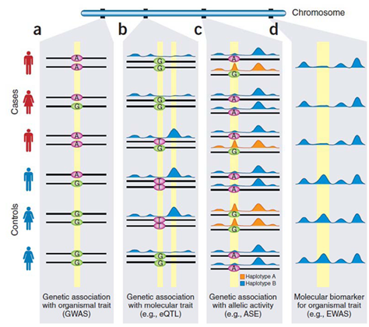
GWAS vs eQTL
Introduction Data Method Results
Explanatory variable
Response variable
Expanatory variable
Response variable
http://www.biogenius.cn/htm/solution/BigData/complexdisease/218.html

Slide 10
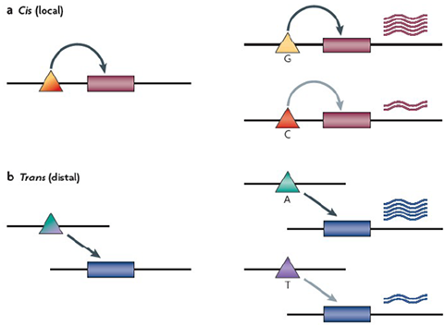
Cis vs Trans
Introduction Data Method Results
eQTL classified as ‘local’ and ‘distal’ depending on the distance of locus
1 Mb
http://www.biogenius.cn/htm/solution/BigData/complexdisease/218.html

Slide 11
Objectives
Introduction Data Method Results
Prior eQTL studies
Association between GE patterns from the tumor cells and SNP variants also from the tumor cell
cis-eQTL analysis
SNPs from normal cell to explain expression in tumor
Compare eQTL found with published results
Look for target genes that effect the survival

Slide 12
Data
Introduction Data Method Results
The Cancer Genome Atlas (TCGA)
GBM patients
Sample Size: 287 patient had both GE data and genotype data
Clinical information
GBM patients
Genotype data from normal tissue
(TCGA)
Gene expression data from tumor

Slide 13
Genotype & GE data (n=287)
Introduction Data Method Results
 | Genotype Data | Gene Expression Data
Platform | Affymetrix GenomeWide SNP6.0 platform | Affymetrix HT HG-U133A array platform
 | (p = 906,600) | (p = 12,042)
Edition Criteria | Birdseed confidence calls > 0.25 Minor allele frequencies < 10% SNPs out of HWE (p< 0.0001) | Median absolute deviation < 0.5
 | (p = 590,746) | (p = 4,555)

Slide 14
Methods
Introduction Data Method Results
Association study of genotype and gene expression in cis
Comparison of sig cis-eQTL with published results
Breast Cancer
Normal tissue
GBM
Survival analysis relating time to death with significant cis-eQTL found in this study
Evaluation of differential express

Slide 15
1. Association Study
Introduction Data Method Results

Slide 16
2. Compare with published results
Introduction Data Method Results
Published results
Breast Cancer
Li, et al. (2013). Integrative eQTL based analyses reveal the biology of breast cancer risk loci.
1,359 cis association
Normal tissue
RegulomeDB
Based on 9 publications
GBM
Shpak, et al. (2014). An eQTL analysis of the human glioblastoma multiforme genome.
891 cis association

Slide 17
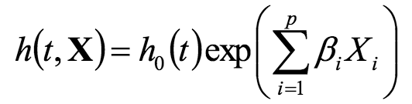
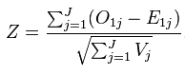
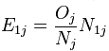
3. Survival Analysis
Introduction Data Method Results
Association of overall survival explained by the eQTL found significant in this study
Cox Proportional Hazard Model
Logrank test
(The hazard or risk of dying at time t.)
https://en.wikipedia.org/wiki/Log-rank_test
http://www.medicine.ox.ac.uk/bandolier/painres/download/whatis/cox_model.pdf

Slide 18
4. Evaluation of Differential Express
Introduction Data Method Results
Whether these target genes are differentially expressed in GBM tumor samples and normal brain tissue
Case
Control
(n = 287)
(n = 10)
(brain tumor tissue)
(normal brain tissue)

Slide 19
1. Association Study
Introduction Data Method Results
1,736,706 unique SNP and gene pairs
985 significant associations were identified

Slide 20
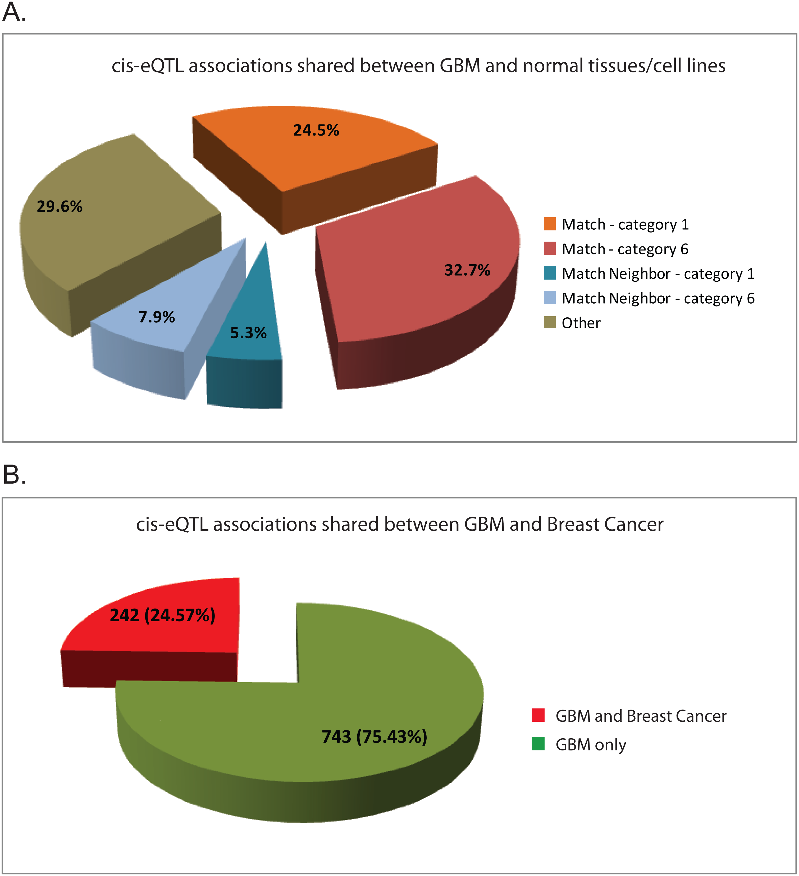
2-1 Compare with Breast Cancer
Introduction Data Method Results
Out of 985 significant cis-eQTL association
Breast Cancer
242 (25%) shared same gene

Slide 21

2-2 Compare with normal tissue
Introduction Data Method Results
RegulomeDB
Large collection of eQTLs covering 142,945 SNPs derived from 9 publications
Score into Category 1 – 6
Magnitude of results in a functional consequence
Category 1: most likely to be significant eQTL
Category 6: no association (false discovery)

Slide 22
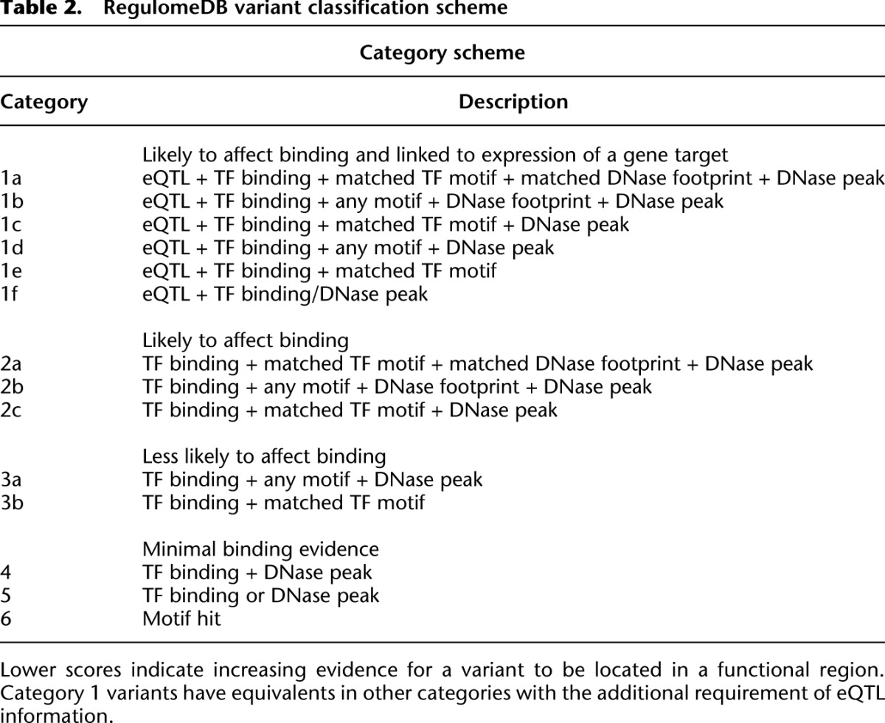
2-2 Compare with normal tissue
Introduction Data Method Results

Slide 23
2-2 Compare with normal tissue
Introduction Data Method Results
Normal tissue
563 (57%) shared same gene
241 (43%) classified as Category 1
24.5/57=43%

Slide 24
2-3 Compare with GBM
Introduction Data Method Results
No overlap
Methodology differences
Different subsets of GBM samples
Different levels of gene expression data
Different filtering methods
Different gene expression value were used

Slide 25
3. Survival Analysis
Introduction Data Method Results
High expression group: gene expression is higher than median
Low expression group: gene expression is lower than median
13 significant eQTL genes associate with survival based on the expression

Slide 26
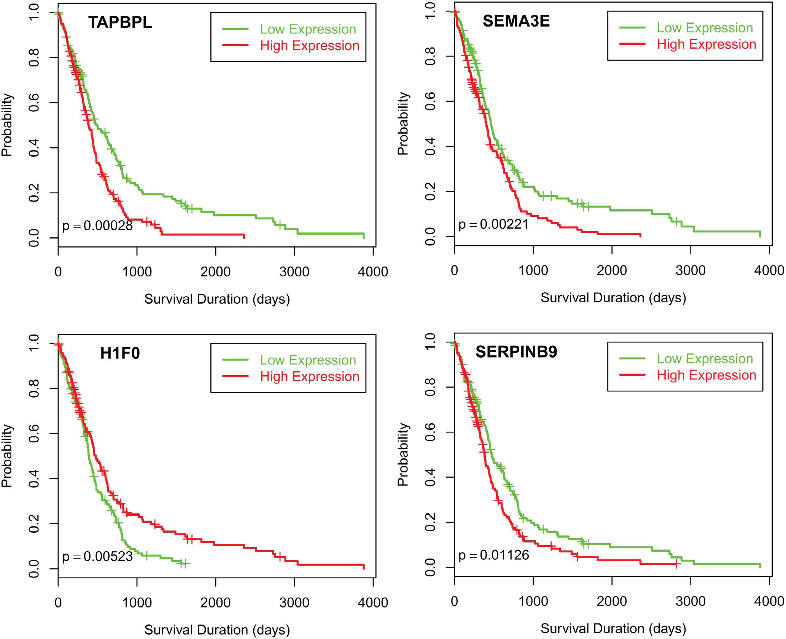
Kaplan-Meier plots
Introduction Data Method Results
Up-regulated

Slide 27
Kaplan-Meier plots
Introduction Data Method Results
Down-regulated

Slide 28
4. Evaluation of Differential Express
Introduction Data Method Results
Gene | t | p value
TAPBPL | 11.653 | 3.27E-08 ***
SEMA3E | -1.822 | 8.35E-02
H1F0 | 2.915 | 1.53E-02 *
SERPINB9 | 3.613 | 4.28E-03 **
HMBOX1 | 3.028 | 1.03E-02 *
RCAN1 | 20.389 | 1.02E-22 ***
NAA38 | 28.941 | 4.88E-17 ***
MGST3 | -17.308 | 1.29E-11 ***
TMBIM4 | 11.339 | 3.05E-07 ***
JUNB | 4.016 | 2.14E-03 **
THNSL2 | -0.521 | 6.14E-01
IL4R | 7.109 | 7.03E-06 ***
LY75 | 11.126 | 1.04E-08 ***

Slide 29
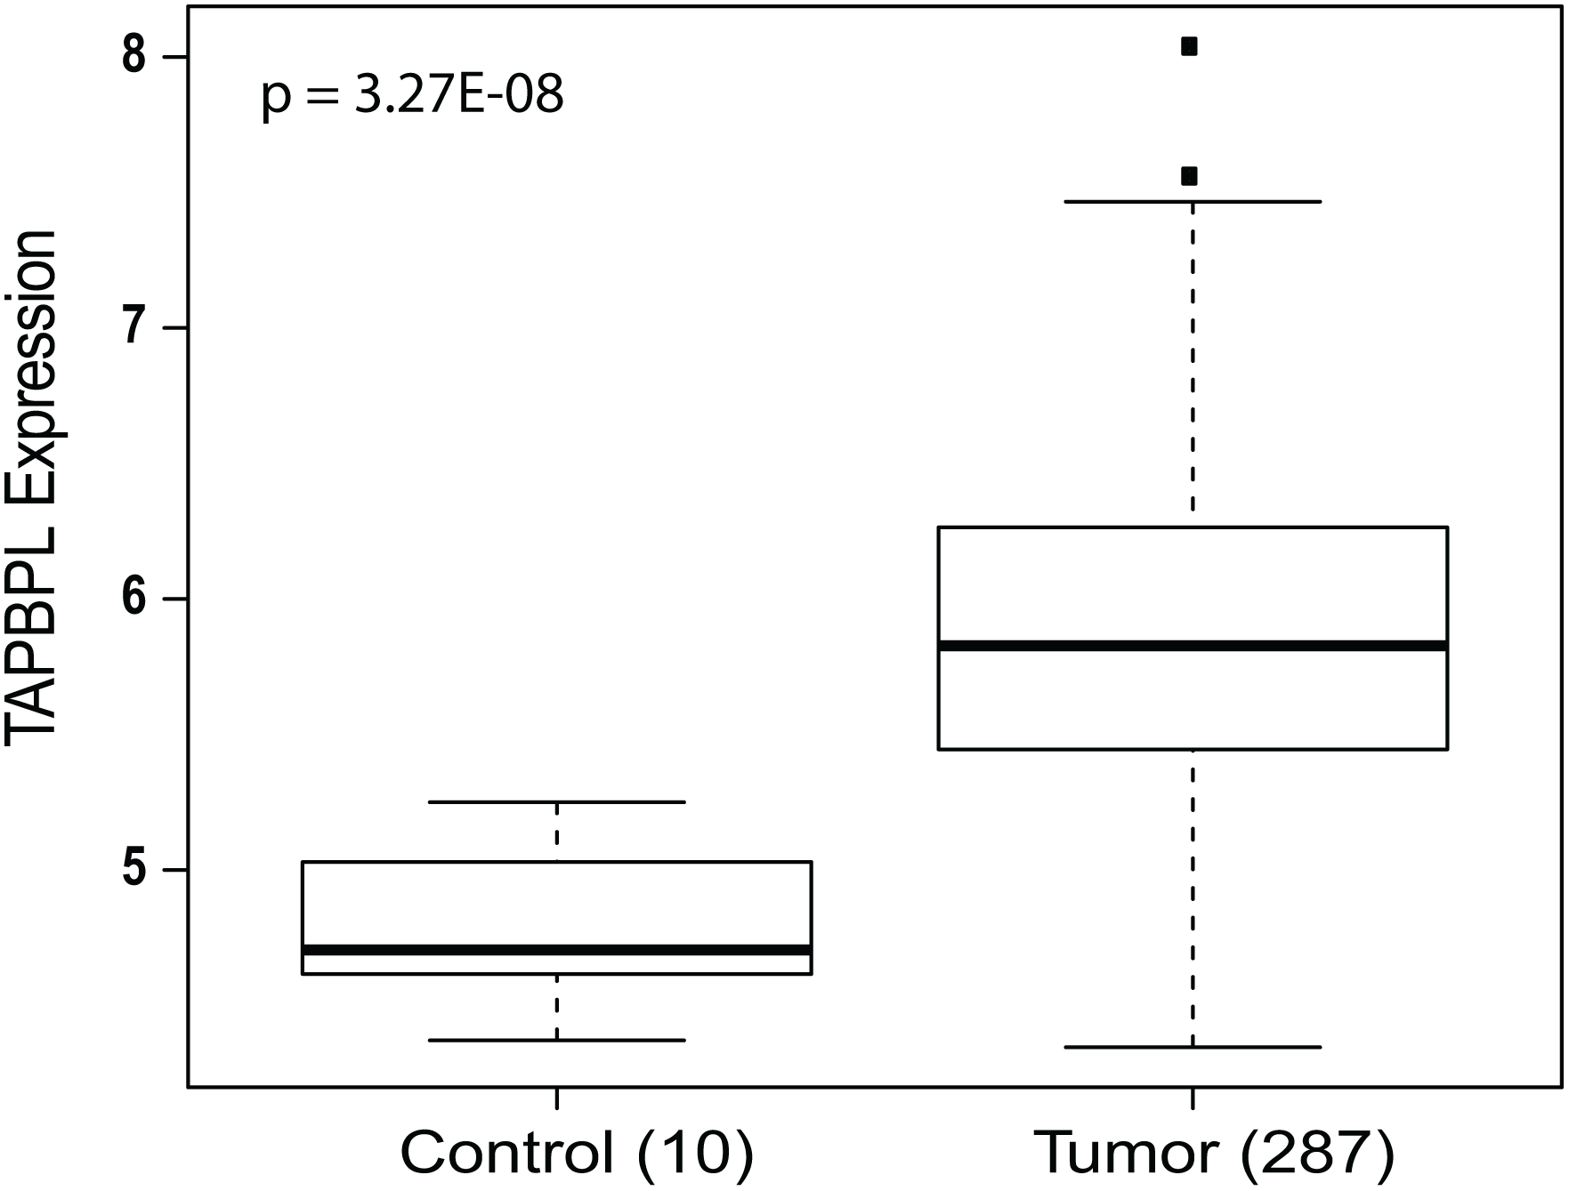
4. Evaluation of Differential Express
Introduction Data Method Results

Slide 30
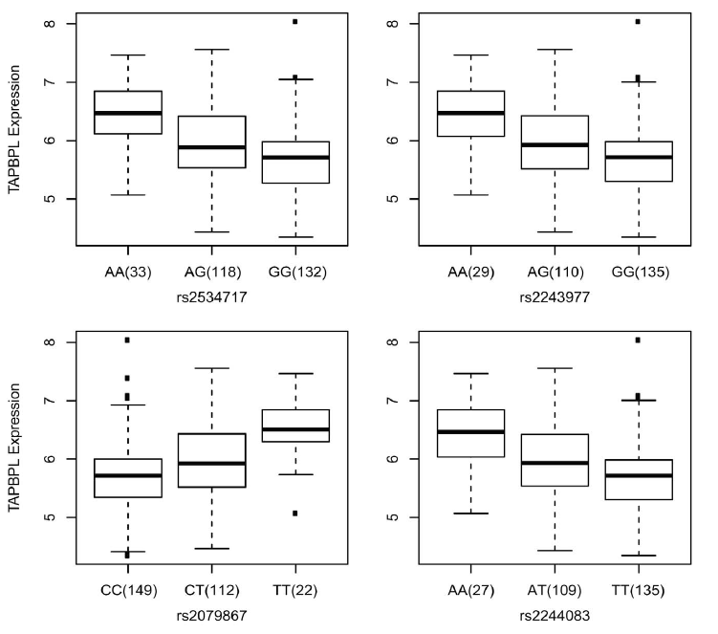
Correlation of GE and genotype
Introduction Data Method Results
Gene Expression
genotype
genotype

Slide 31
Conclusion
Introduction Data Method Results
cis-eQTL highly overlap in tumor and normal tissue
confidence of detecting true positive cis-eQTLs
same set of genetic variations existing in normal tissues are making contributions to tumor gene expression
involved in cancer pathogenesis

Slide 32
Conclusion
Introduction Data Method Results
cis-eQTLs overlap in GBM study and Breast Cancer
Common cis-eQTL associations highly exist across cancers as well
The genetic variants is affecting the survival
Important to the understanding of genetic contribution to GBM cancer pathogenesis and prognosis

